Slide 1

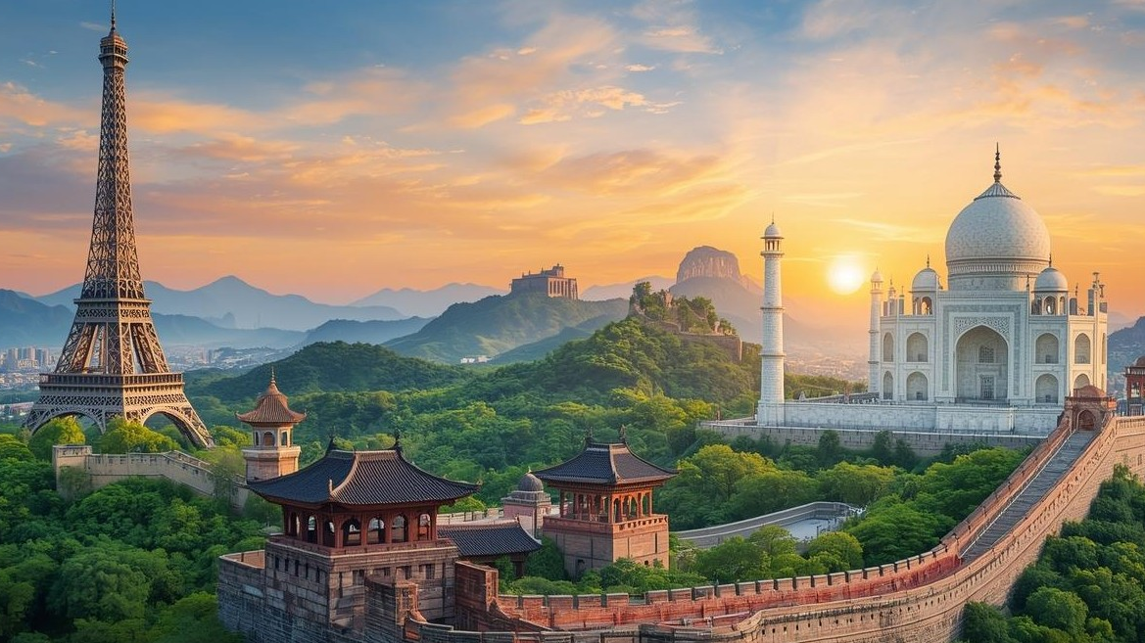

Slide 2








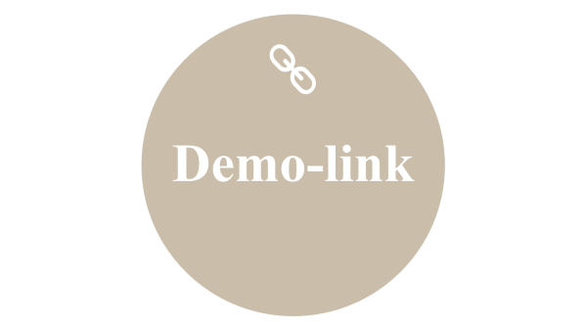


Slide 3

TITLE

Slide 4
Dream Traveler Agency
Group Members:
Awais Aleem (2025-CS-223)
Ahmed Bilal (2025-CS-207)
Ahmad Raza (2025-CS-228)
Rana Abdullah (2025-CS-196)
Ahsan Abdullah (2025-CS-213)
Cource:
AICT Lab
Cource Instructore: Ms. Ramsha Khalid
Date:05/01/2026

Slide 5

Objective

Slide 6
Objective
To design a professional travel agency website
To practice HTML page structure and CSS styling
To improve UI design and navigation skills
Develop a static website without using any backend technologies
Present travel information and services in a clear and organized manner
Design a desktop-responsive layout for better user experience
Create an educational project to practice and learn web development fundamentals

Slide 7

Home Page

Slide 8

Home Page
Introduction to Dream Traveler Agency.
It includes Gallery, Contact Us , Packages, and Our Services button.
This page also have Google map.

Slide 9

Packages

Slide 10
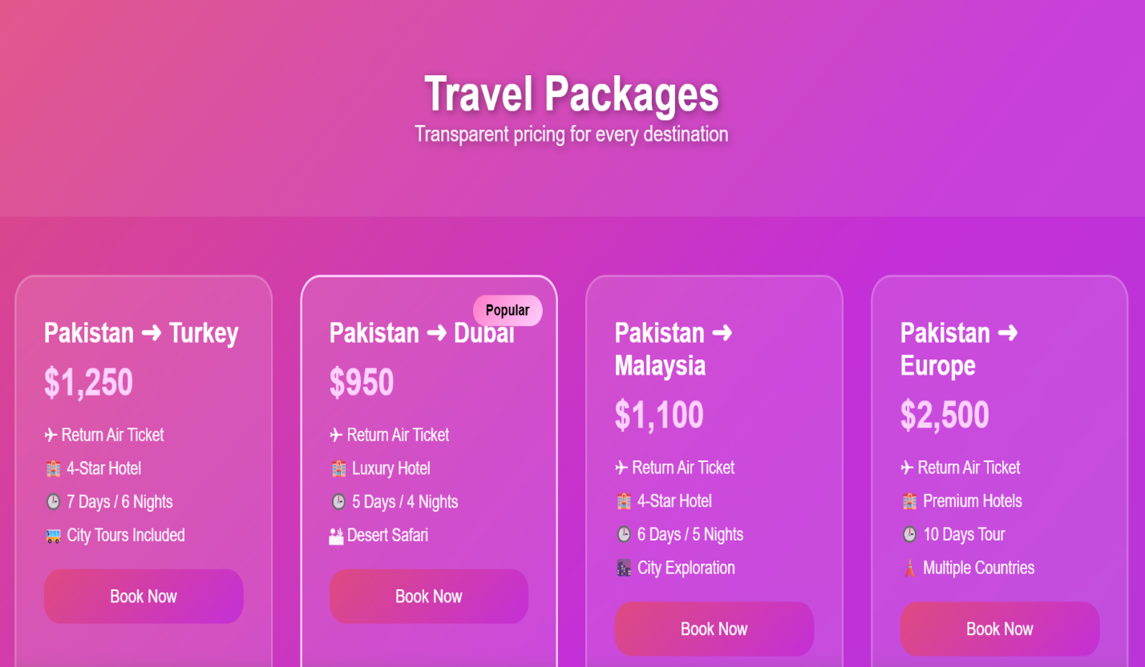
Packages
display packages.
Display duration.
Display price.
There is a contact us button to contact for booking

Slide 11

Contact Us

Slide 12
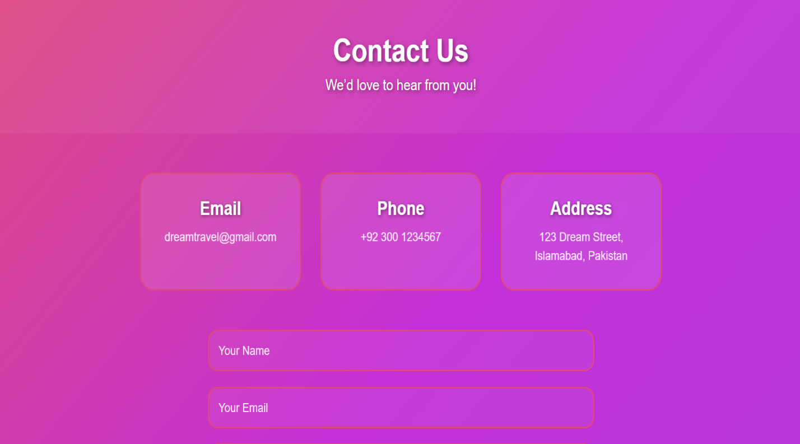
Contact Us
Section whrere user enter name, email etc.
Through this page user contact agents

Slide 13

Data From Excell

Slide 14
Data From Excell
Summary Table
Description | Result
Total Packages | 6
Total Revenue | 6,200
Average Package Price | 1,033
Highest Price | 2,500
Lowest Price | 150
Graph shows price of tours.
Summary table shows the calculation perform on data.

Slide 15

Design

Slide 16

Design
Fonts
Headings: ‘Poppins’ / Sans-Serif
Paragraph text: ‘Poppins’ / Sans-Serif
Colors
We use the contrast of Pink and it’s variation.
Layout Decisions
Sticky header navigation
Hero section on home page
Card-based package design
Flexbox and grid layout for responsiveness

Slide 17

Reflection

Slide 18
Reflection
Understood how to structure a website using HTML
Learned to style web pages effectively using CSS
Gained experience with layout techniques and color selection
Learned the basics of responsive design
Future improvement: add JavaScript for interactivity
Future improvement: integrate a backend for booking and user data storage

Slide 19

Demo-link

Slide 20
Demo-link
Live Website:
https://iawaisaleem.github.io/Group_06-Dream-Traveler-Agency/
GitHub Repository:
https://github.com/iawaisaleem/Group_06-Dream-Traveler-Agency
Deployment Tool:
GitHub Pages

Slide 21

Thanks for Attention

